Slide 1
Carbon assimilation pathways
Part one: Brief summary of the four pathways for assimilation of C1 compounds
The elucidation of the Serine Cycle up to 1973
Part two: The solution of the complete Serine / Ethylmalonyl-CoA cycle

Slide 2
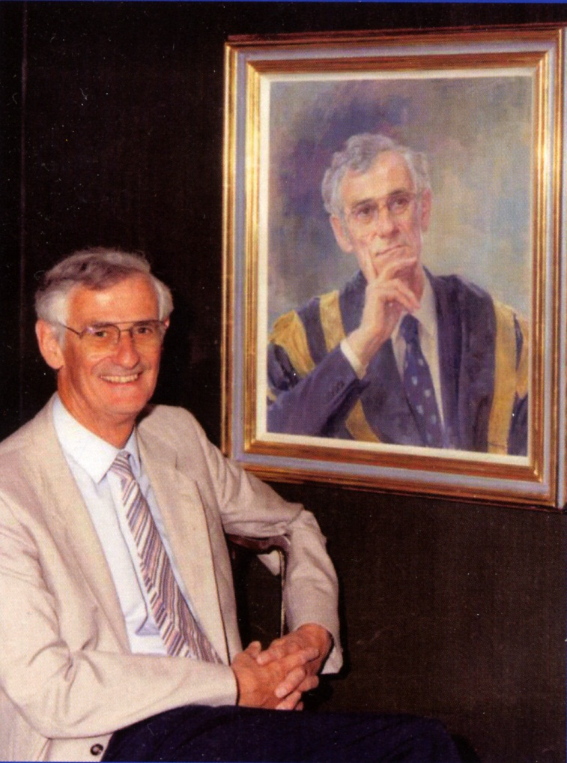
Gordon Research Conference: Magdalen College, Oxford, 2006
Molecular Basis of Microbial One-Carbon Metabolism
The Biochemistry of Methylotrophs: a historical perspective
Chris Anthony, University of Southampton, UK
Dedicated to the memory of J. Rod Quayle (1926 – 2006)
1946 – 1951 PhD in physical-organic chemistry [University of Wales; with ED Hughes]
PhD on aphid pigments [Cambridge with Alexander Todd
1953 --1954 Calvin’s lab at Berkeley
1955 --1963 Krebs’ MRC Unit at Oxford
1963 – 1983 University of Sheffield
1983 – 1992 Vice-Chancellor, University of Bath
Many of my slides are from this lecture dedicated to Rod Quayle

Slide 3
Carbon assimilation pathways of methylotrophs
Ribulose bisphosphate [RuBP] pathway [Key contribution from JRQ]
Plants, autotrophic bacteria and a few methylotrophs
Pathways first proposed by Quayle and mainly elucidated by him and his colleagues:
Ribulose monophosphate [RuMP] pathway
Type I methanotrophs and obligate methanol or methylamine utilisers
Dihydroxyacetone [DHA] pathway
Methylotrophic yeasts
Serine pathway
Type II methanotrophs and facultative methanol or methylamine utilisers
I will summarise the first three and spend more time on details of serine pathway

Slide 4
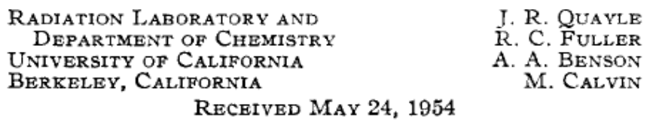
Calvin-Benson cycle for CO₂ fixation in plants [1950 – 1960]
Cell
material
The key demonstration of the specific RuBP carboxylase activity in extracts was published by Quayle in JACS in 1954
RuBP carboxylase
[RUBISCO]
6x CO₂
12x 3-phosphoglycerate
Fructose phosphate
6x Ribulose
bisphosphate
5x Fructose phosphate
Rearrangement reactions
This pathway was soon shown to be the path of carbon dioxide fixation in aerobic autotrophic bacteria and it was commonly assumed that methylotrophs growing on methane or methanol would assimilate their carbon by this pathway after their oxidation to CO₂
JRQ showed that this is the route for formate assimilation by Pseudomonas oxalaticus [1959].
He later showed that the facultative autotroph Paracoccus denitrificans assimilates methanol by this pathway.

Slide 5
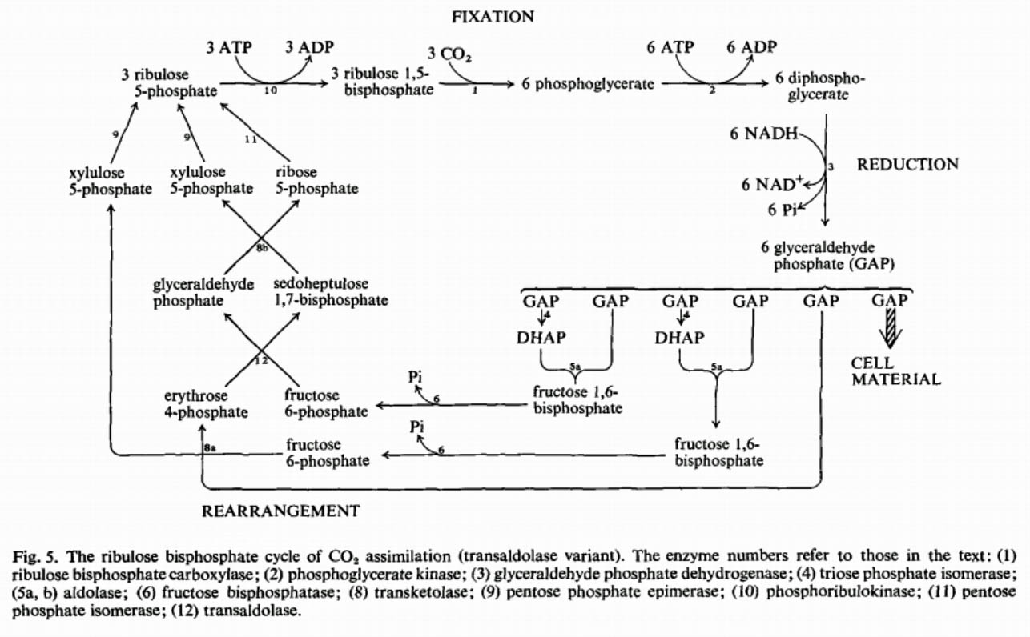
Ribulose Bisophosphate pathway in plants, autotrophs
and some methylotrophs

Slide 6
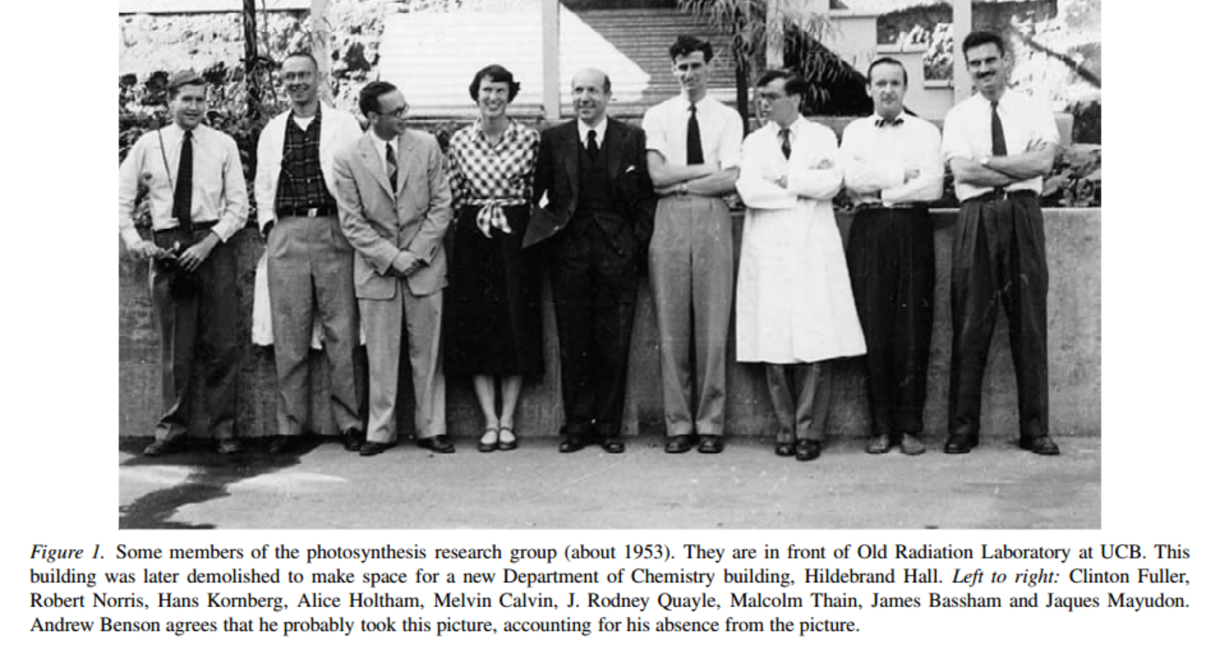

Slide 7
The ribulose monophosphate pathways
Quayle, Johnson, Strom, Ferenci, Kemp, [1965 – 1974]
Occur in Type I methanotrophs and in the obligate methanol or methylamine utilisers. There are 4 variants; three of these have been demonstrated in different bacteria.
Methods: Short term labelling experiments; analysis of position of label in metabolites, purification and characterisation of enzymes; measurement of all enzymes of the pathway.
Similar to Ribulose bisphosphate (Calvin) cycle except for ‘first reaction’
Condensation of formaldehyde with RuBP to give a novel hexulose phosphate; this is then isomerised to fructose 6 phosphate. The novel synthase and isomerase were isolated and characterised.
Subsequent reactions of the pathway are similar to the rearrangement reactions of the Calvin cycle.

Slide 8
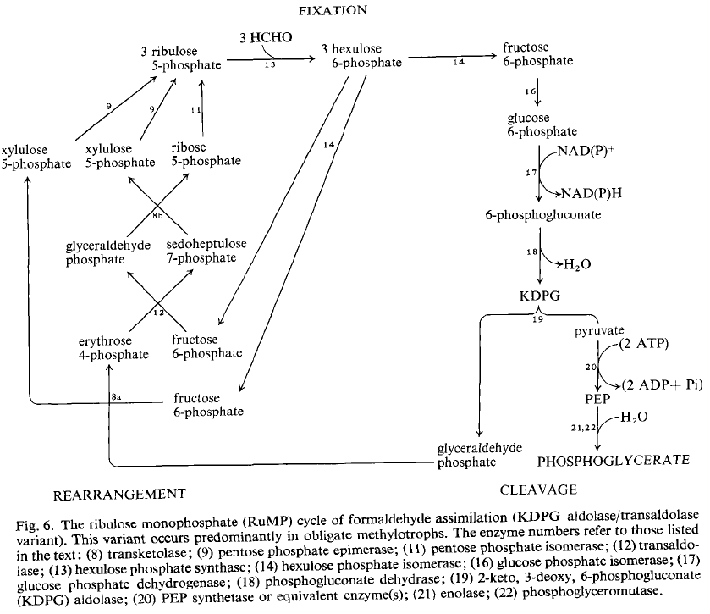
RuMP pathway

Slide 9
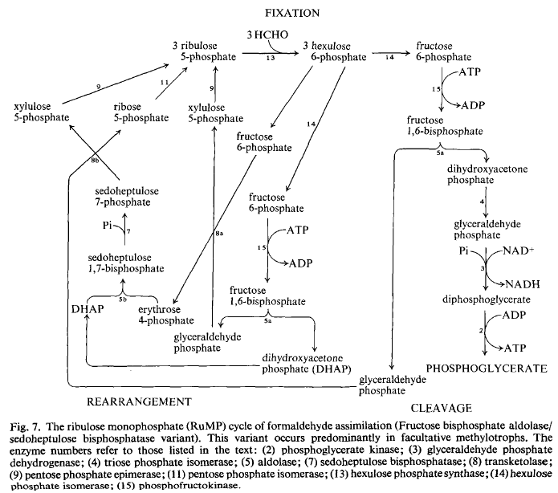
RuMP pathway

Slide 10
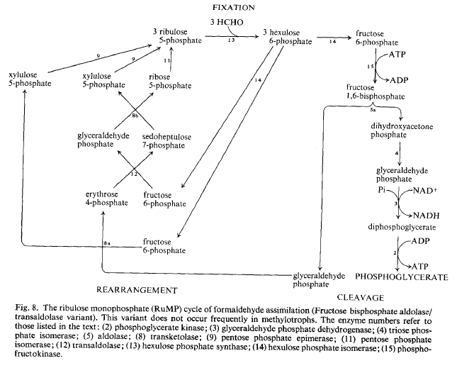
RuMP pathway

Slide 11
The dihydroxyacetone [DHA] cycle of formaldehyde assimilation in yeasts
Nobuo Kato, O’Connor (Mary Lidstrom), Sahm, Babel, van Dijken, Quayle [1977-1981]
This is similar to the RuBP and RuMP cycles
Two specific enzymes are required for formaldehyde fixation:
DHA synthase and triokinase
These were purified and characterised
Short term labelling pattern from 14C methanol was consistent with the cycle proposed by Quayle and distribution of labelled carbon in the proposed intermediates was consistent with the cycle
Mutants lacking the key enzymes were unable to grow on methanol

Slide 12
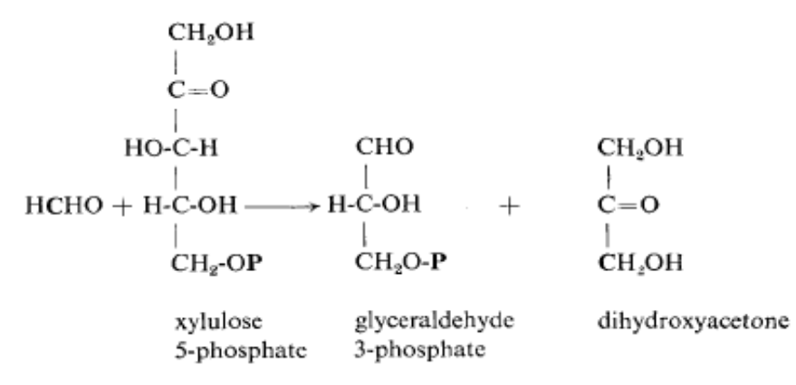
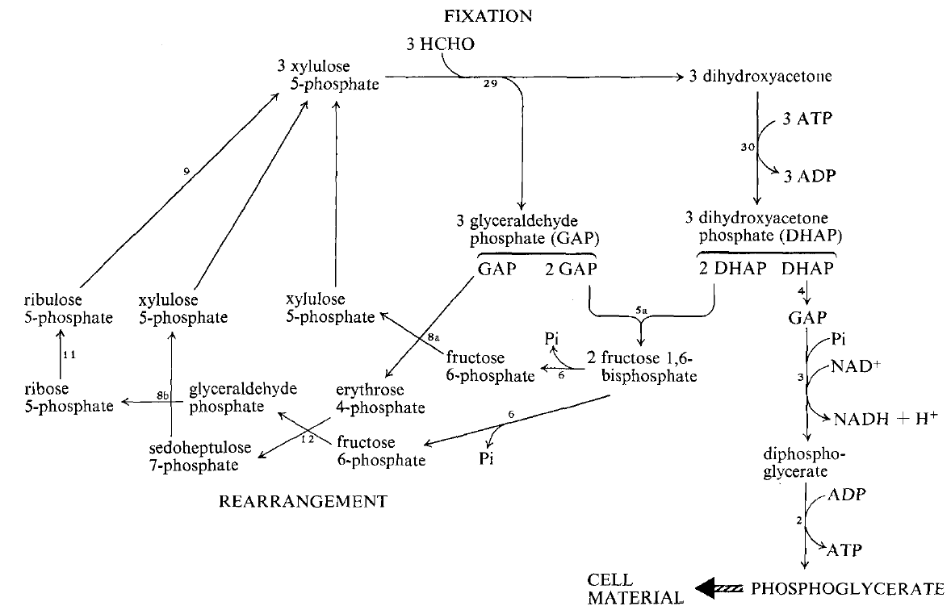
DHA cycle in yeast
Fixation: xylulose phosphate +HCHO
glyceraldehyde phosphate + dihydroxyacetone

Slide 13
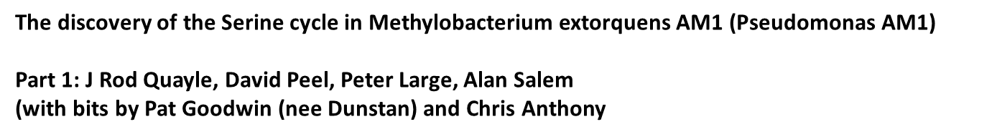
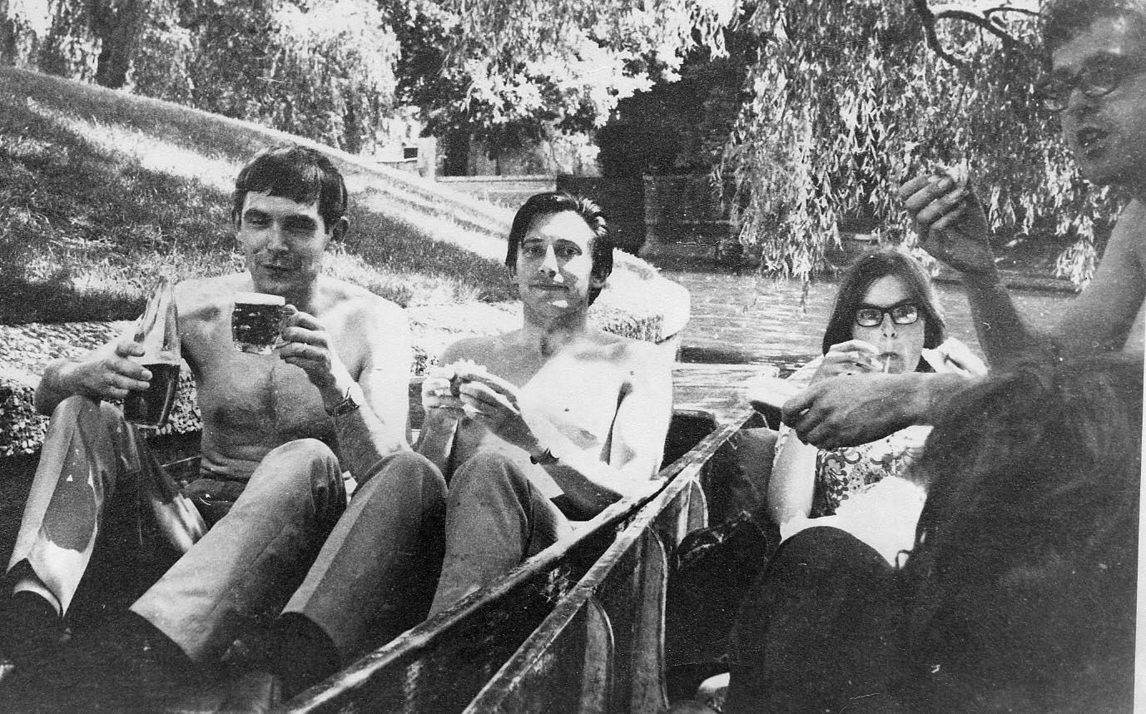
Bob
Peter
Peter Large
J. Rod Quayle

Slide 14
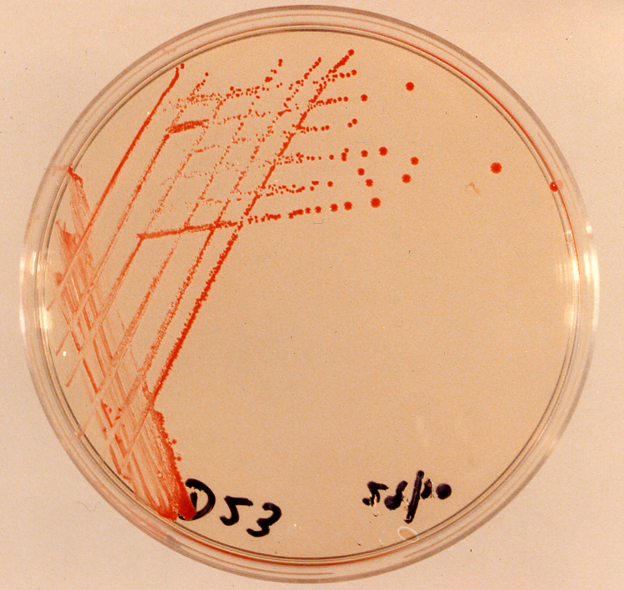
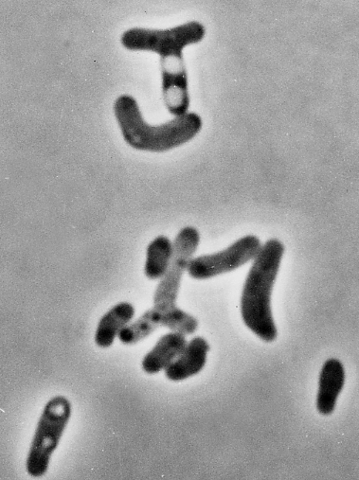
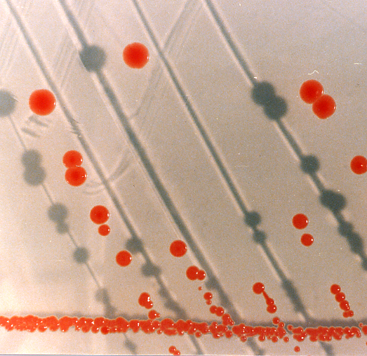
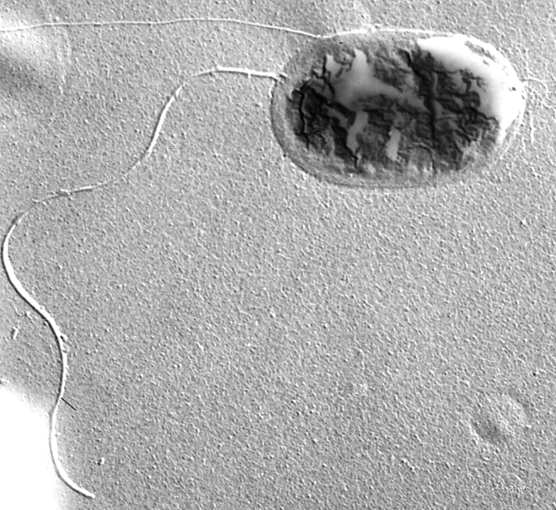
Methylobacterium extorquens
Pseudomonas AM1 (Peel & Quayle, 1961)
Pseudomonas sp. M27 (Anthony & Zatman, 1964)
CH₃OH
HCHO
HCOOH
CO₂

Slide 15
The Serine Pathway; Peter Large, David Peel and Rod Quayle
1961 - 1963
1. Large, P.J., Peel, D. and Quayle, J.R. Biochemical Journal 81 , 470-480 (1961).
Microbial growth on C1 compounds: Synthesis of cell constituents by methanol- and formate-grown Pseudomonas AM1 and methanol-grown Hyphomicrobium vulgare.
2. Large, P.J., Peel, D. and Quayle, J.R. Biochemical Journal 82, 483-488 (1962).
Microbial growth on C1 compounds: Distribution of radioactivity in metabolites of methanol-grown Pseudomonas AM1 after incubation with [14C]methanol and [14C]bicarbonate.
3. Large, P.J., Peel, D. and Quayle, J.R. Biochemical Journal 85, 243-250 (1962).
Microbial growth on C1 compounds: Carboxylation of phosphoenolpyruvate in methanol-grown Pseudomonas AM1.
4. Large, P.J. and Quayle, J.R. Biochemical Journal 87, 386-396 (1963).
Microbial growth on C1 compounds: Enzyme activities in extracts of Pseudomonas AM1.

Slide 16
The Elucidation of the Serine pathway in Pseudomonas AM1 [now Methylobacterium extorquens AM1]
A pink facultative methylotroph; grows on methanol, not methane
Bacteria were grown on ¹⁴C MeOH and the label in cell material recorded. If RuBP pathway is operating then passage of ‘cold’ ¹⁴CO₂ would decrease the label by 95%
RuBP carboxylase
[RUBISCO]
¹⁴C Cell
material
¹⁴CH₃OH
¹⁴CO₂
¹⁴C 3- phosphoglycerate
Passage of ‘cold’ CO₂ through the culture during growth on ¹⁴CH₃OH decreased label in cell material by about 50%. This shows that half the carbon enters the biosynthetic pathway as CO₂ produced from the methanol
RuBP carboxylase is absent
Short term labelling experiments showed that 3- phosphoglycerate is not an early intermediate when whole cells are incubated with ¹⁴CH₃OH or H¹⁴COOH

Slide 17
Short term label experiments to determine path of carbon
Incubate growing cells with ¹⁴CH₃OH or ¹⁴CO₂ (bicarbonate)
Take samples into boiling ethanol at 2,4,8,20 secs etc
Separate all soluble components by 2-way paper chromatography
Identify labelled compounds by autoradiography (3 weeks)
Elute, count ¹⁴C and confirm identity by co-chromatography with known compounds
Plot % radioactivity in each compound against time. A negative slope indicates an early intermediate.
After 1 min incubation the early intermediates were chemically analysed to determine the specific radioactivity in each carbon atom

Slide 18
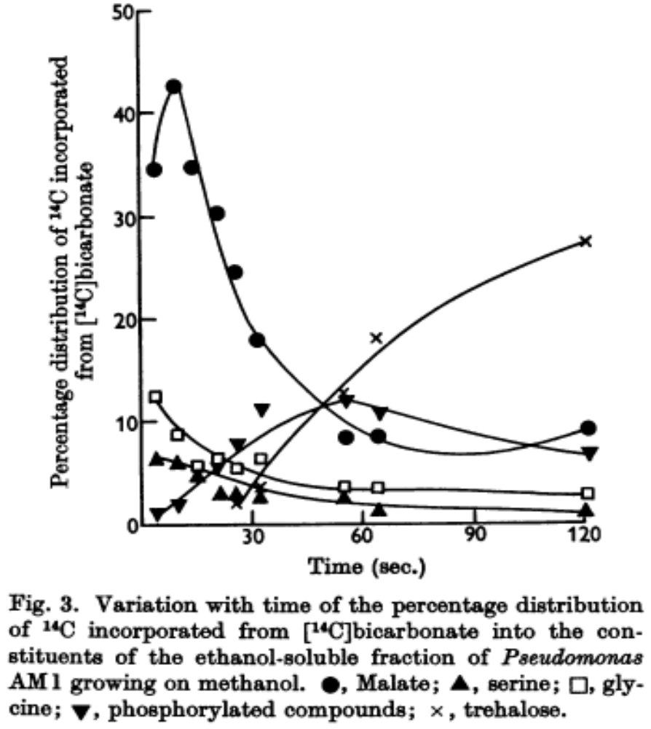
Distribution of label in cells incubated with labelled CO₂
Negative slope = earliest intermediates
Malate [reflecting oxaloacetate, OAA]
Glycine; Later - serine
Suggests typical carboxylation of a C3 to a C4 compound [OAA / malate]
And either cleavage of C4 to glycine
Or novel carboxylation to give glycine
malate
glycine
Phosphorylated compounds
NB: the presence of a labelled compound at 20 seconds does not indicate an early intermediate.
Coenzyme A derivatives are cannot be seen in this sort of experiment.
Similar results were obtained using Hyphomicrobium vulgare

Slide 19
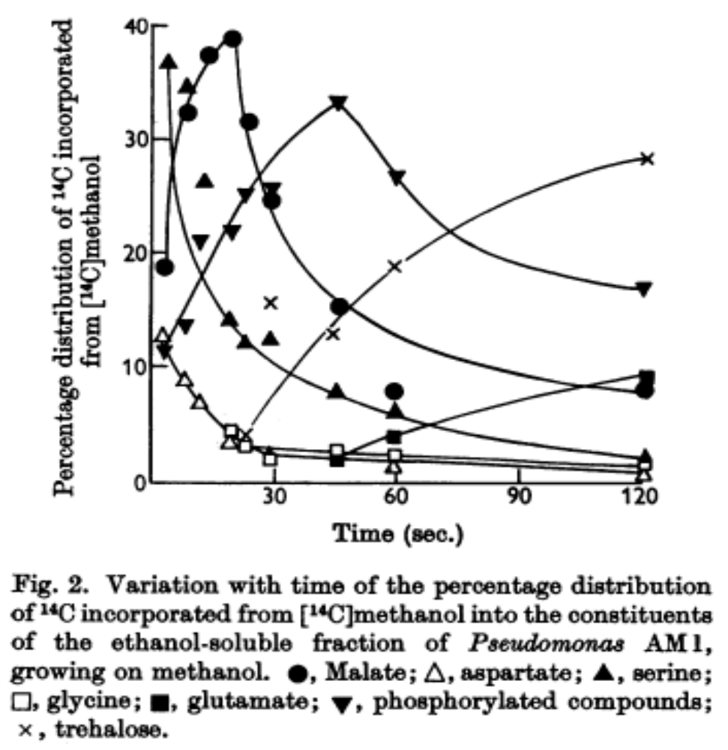
Distribution of label in cells incubated with methanol
Negative slope = early intermediates
Serine Malate Aspartate Glycine
Phosphorylated compounds
Suggests:
Addition of HCHO to glycine to give serine
A derivative of serine is carboxylated to OAA / malate / aspartate
Similar results were obtained using Hyphomicrobium vulgare

Slide 20
Distribution of ¹⁴C in carbon atoms of early intermediates
Cells were incubated for 1 minute with ¹⁴C MeOH or ¹⁴HCO₃; Intermediates were purified, chemically degraded and ¹⁴C in each C atom determined and expressed as % of total counts in the compound
Conclusions
1. Carboxyl group of glycine comes from carbon dioxide; methylene carbon comes from methanol
2. Hydroxymethyl group in serine comes from methanol; the other 2 carbons mimic the distribution seen in glycine
3. Serine arises by hydroxymethylation of glycine
From methanol
From bicarbonate
Glycine
CH₂NH₂
COOH
50 50
15 85
Serine
CH₂OH CHNH₂ COOH
50 25 25
2 15 83

Slide 21
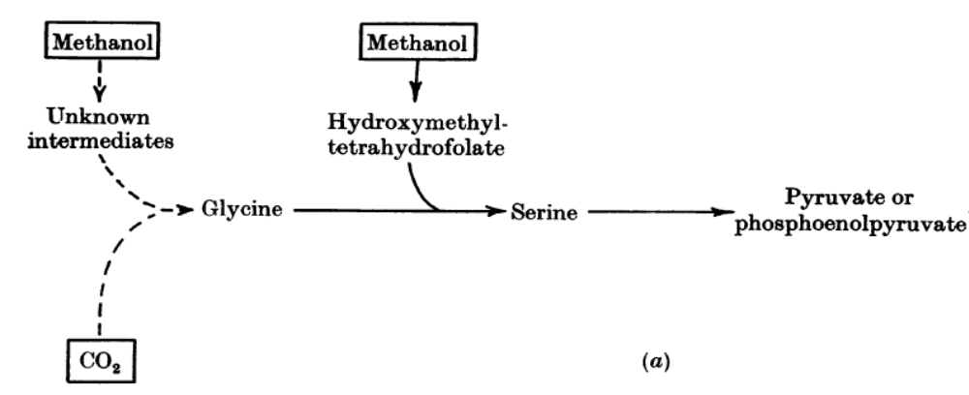
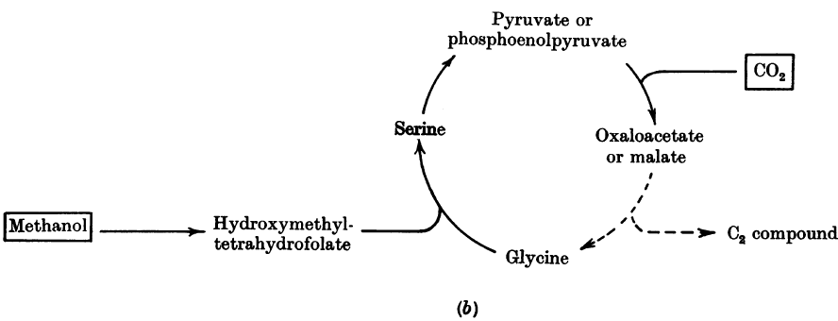
Two possible routes for conversion of methanol plus CO₂ to cell material
Cell material
These 2 routes were proposed by Quayle and the cleavage route (below) later confirmed
NOTE: key difference is production of glycine by direct condensation (above) or by cleavage (below)
Cell material
C2 - compound

Slide 22
The serine cycle involves a cleavage reaction
Malyl-CoA lyase: malyl-CoA glyoxylate + acetyl-CoA
[Salem & Quayle 1973]
glycine
What happens to the acetyl-CoA?
In icl⁺ bacteria: isocitrate lyase is involved in oxidation of acetyl-CoA to glyoxylate; in these bacteria ICL is also involved during growth on ethanol or acetate
In icl⁻ bacteria with no isocitrate lyase [eg Methylobacterium extorquens]
This route is not yet fully established.
It is also involved in metabolism of C2 compounds

Slide 23
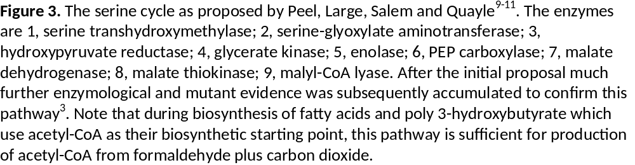
ATP
ADP
H₂O
phosphoenol-
pyruvate (PEP)
glycerate
4
phosphoglycerate
5
NAD⁺
CO₂
3
6
NADH
Pi
hydroxypyruvate
oxaloacetate
CELL MATERIAL
NADH
2
7
serine
NAD⁺
malate
Acetyl-CoA
ATP
CoA
1
HCHO
8
ADP
Pi
glycine
glyoxylate
malyl-CoA
2
9

Slide 24
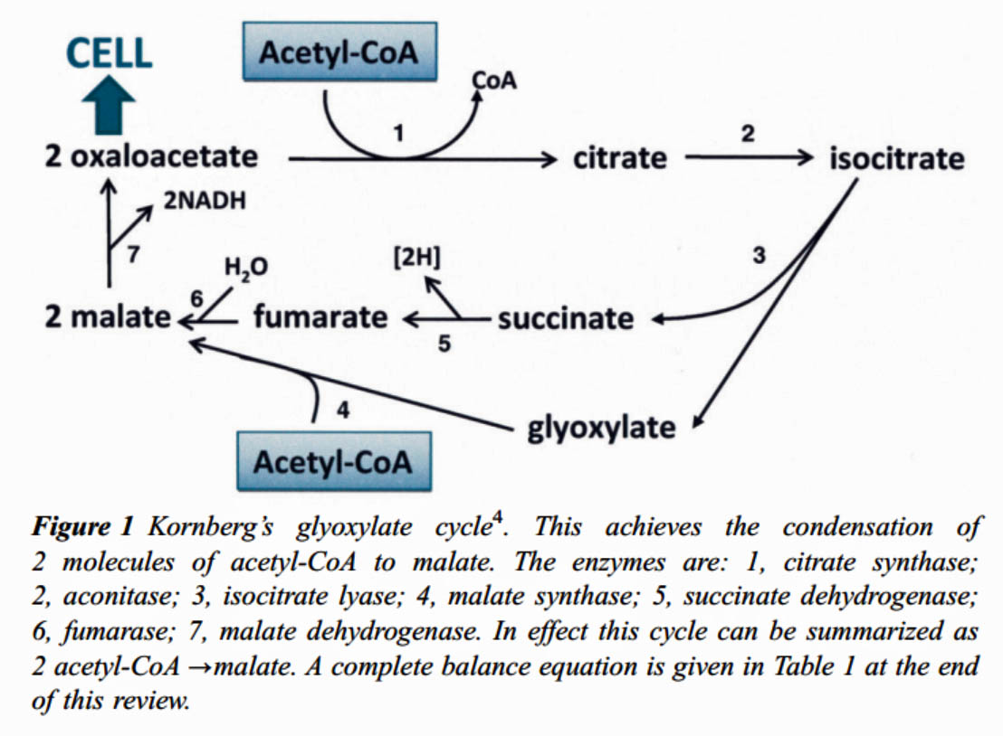
The Glyoxylate cycle for growth on C2-compounds

Slide 25
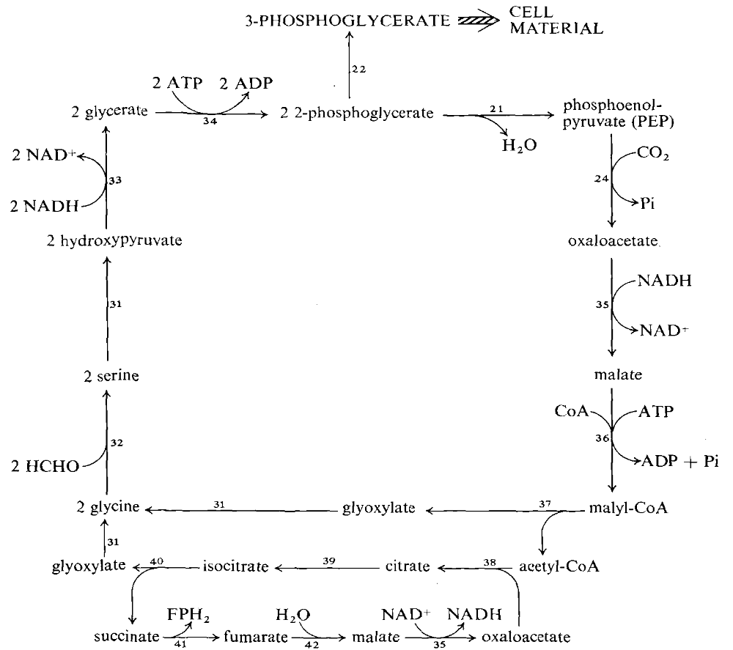
*
*
*
The icl⁺ serine cycle
*
Specific transaminase
*
*
ICL

Slide 26
Confirmation of serine cycle
The proposed pathway fits the early labelled intermediates
The distribution of labelling in the intermediates fits the pathway
The 5 novel enzymes were purified and characterised
They were shown to be inducible on methanol
They were of sufficiently high specific activity to account for the growth rate on methanol
Mutants lacking them failed to grow on methanol; revertants had regained the enzyme
Later shown that key enzymes were coordinately regulated, implying the presence of an operon [Dunstan (Goodwin) & Anthony; Hanson & O’Connor (Lidstrom)]

Slide 27
The serine cycle in icl⁻ bacteria [eg M. extorquens]
glyoxylate
acetyl-CoA
?????????????????

Slide 28
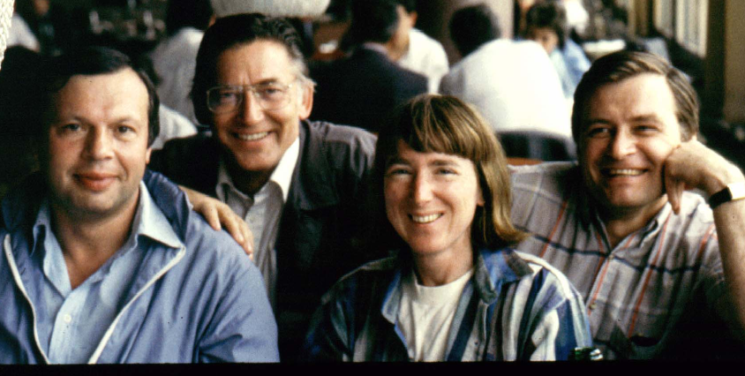
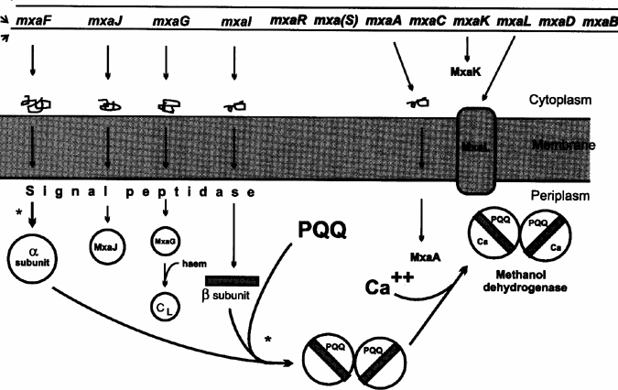
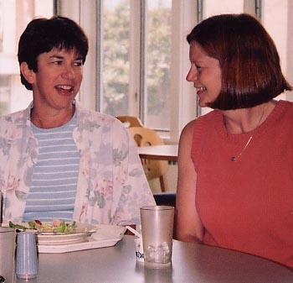
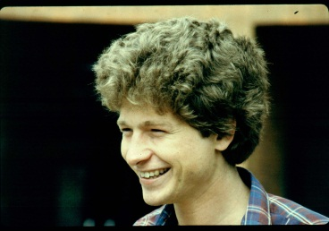
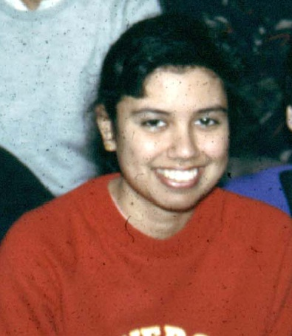
Expression of the mxa operon
Yuri
Sasha
Pat
MxaL
Mary
Karen
Amaratunga
The genes: Nunn, Lidstrom, Amaratunga, Anderson, Anthony, Goodwin, Morris, O’Connor

